Slide 1

Building a calculator

Slide 2
Recap
Installed Thonny
print(“Hello world”)
Variables
variable = “hello world”
print(variable)
input(“Enter something: ”)
if & else statement
while() loop
int(input())

Slide 3




Example
What does this mean?

Slide 4
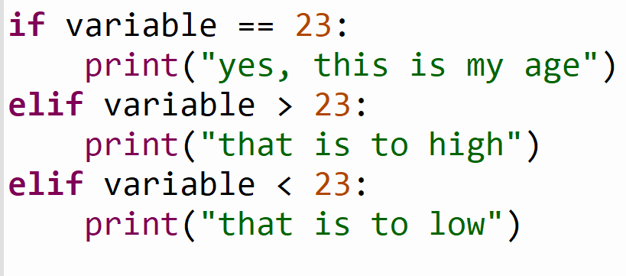
Example
What will the elif do?

Slide 5
Calculator
What do we need to build a calculator?
2 numbers
An operator (+, -, /, *)
An output

Slide 6
Calculator
What do we use from our Python knowledge?
print()
input()
variables
if & elif & else
int()
while() (optional)

Slide 7
Assignment build the calculator (20 min)
There are 3 inputs, 2 numbers and 1 operator(+, -, *, /)
Check the inputs on one of the inputs.
print the result like this: (1 + 1 = 2) or (2 * 2 = 4)
Optional:
Use the while loop
Extend it with square and/or root (google this)

Slide 8
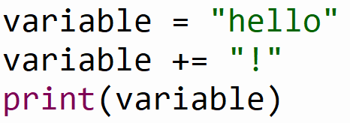
Example
What will the += do?

Slide 9
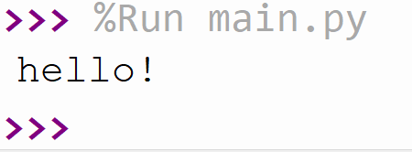
Example

Slide 10
Example
What will the += do?

Slide 11
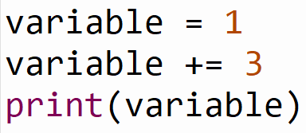
Example
What will the += do?

Slide 12
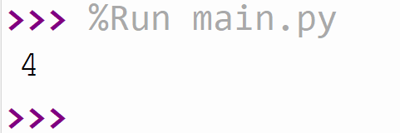
Example

Slide 13
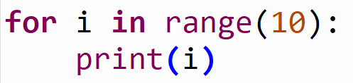
Example
What do you think this will do?

Slide 14
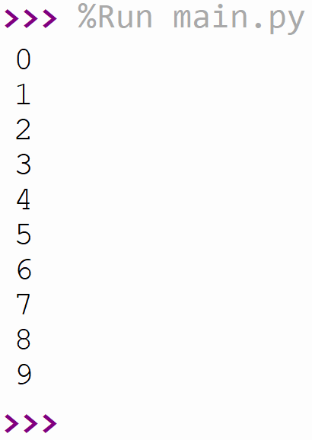
Example
A loop from 0 to 10

Slide 15
Assignment sum (15 min)
Ask for a number input from the user.
Create a variable with the value 0.
Use the for loop to go until the input from the user.
Add the number to the created variable.
print the end result
So if the input is 5 the result should be:
0 + 1 + 2 + 3 + 4 = 10
10 should be printed

Slide 16
Assignment triangular number (10 min)
This assignment is the same as the previous but now you need to figure something out yourself.
Create a for loop that goes from 1 until the number given by the user.
So if the user gives 5 as in input the result must be:
1 + 2 + 3 + 4 + 5 = 15
15 should be printed

Slide 17
Summary
elif statement
variable += “string” / += 1
for loop
How to google a problem
Created a simple calculator
Created a for loop that calculates a triangular number

